Slide 1
Project Benson
MTA Turnstile Ridership Analysis
Group 4
Audrey Baker, Brad Davies, Brad Solomon, Kevin Stern, Will Stokvis
Notes:
BRAD DAVIES:
Names
Group #

Slide 2
Agenda
Overview
Insights
Recommendations
Notes:
BRAD DAVIES: Overview: project objective, executive summary, approach

Slide 3
Overview

Slide 4
Project objective
Optimize street teams at the entrance of subway stations to reach potential attendees and contributors for WTWY’s summer 2018 annual gala
Notes:
Brad Davies:
Gala is in the summer
Attendees: Educated, driven, women and people in tech
Making assumption that you want to mobilize your street teams within the next three months (therefore we analyzed Q1 2017 data)

Slide 5
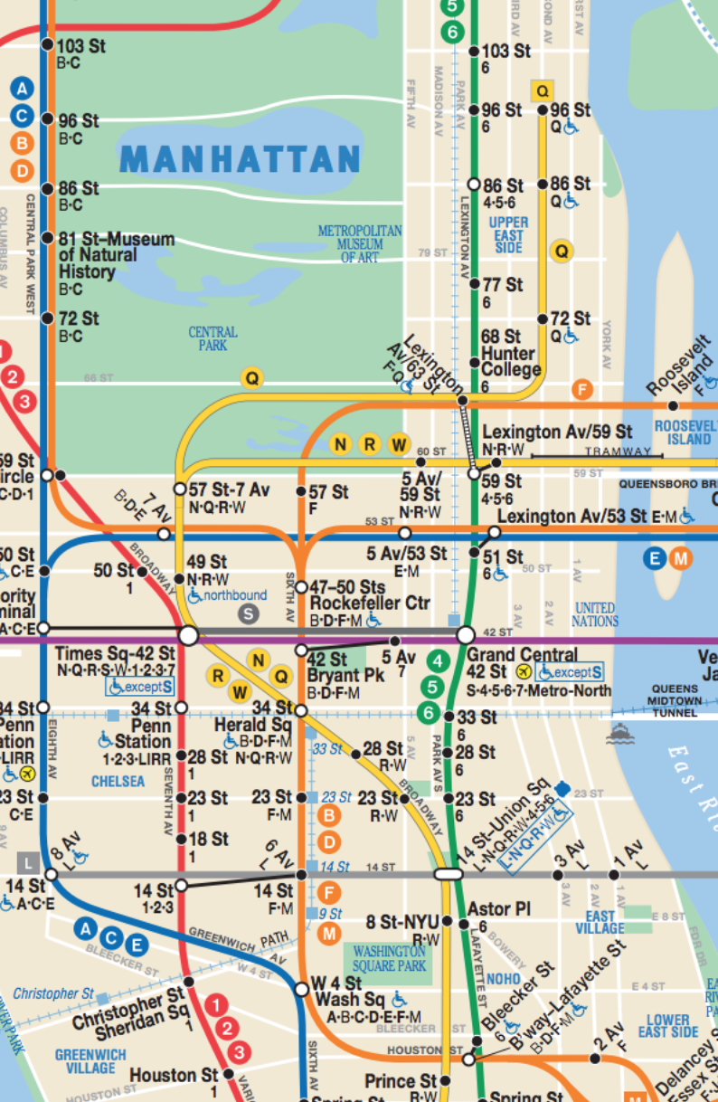
Executive summary
Focus resources on high traffic stations and times
Consider demographics and proximity to tech centers alongside nominal MTA ridership numbers
Notes:
BRAD DAVIES:
Ridership dips Sat/Sun. Focus on weekdays
Demographics – Morning Commute, Tech Centers – Evening Commute
Mention map: these are the recommendations that we suggest, and my colleagues will go into that in more depth

Slide 6
Approach
Compute total entries per station entrance by time of day
Morning Target: Weight entries by American Community Survey (ACS) demographic data to reach driven professional women
Evening Target: Filter by tech business centers to reach tech workforce
Notes:
KEVIN STERN:
Q1
4 Hr
Rush Hour
Augment
Morning
ACS
Evening
Tech
Handoff
Because you want to mobilize in the next 3 months, we used Q1 2017 data to best optimize street teams
First, we used the MTA dataset to construct raw entries by time of day (4 hour intervals). We saw that the morning and evening rush hours had the highest traffic
Talk about data sources
ACS – social & economic characteristics
Tied ACS data to the location of the subway entrances
Why this is used only to weight the morning commute
Tech Business Center Filters
We filtered our entry data by neighborhood that have a high concentration of tech businesses
Why this is used to filter the evening commute
the number of entrants for each station in each 4-hour period.
▶️ Example: Grand Central-42 St. clocked ~27k entries on 3/31/17 between noon-4pm.
Pinpoint optimal subway stations based on greatest number of entries for the target demographic
Assumptions:
Target wealthy, educated women

Slide 7
Insights

Slide 8
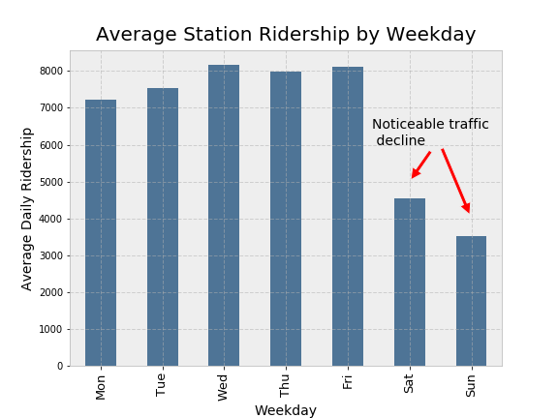
Notes:
BRAD SOLOMON
As Kevin highlighted
We believe it will be most profitable for the group to focus its resources on weekdays
This chart shows mean station ridership by weekday
Marked decline on the weekends
This occurs independent of station or time of day

Slide 9
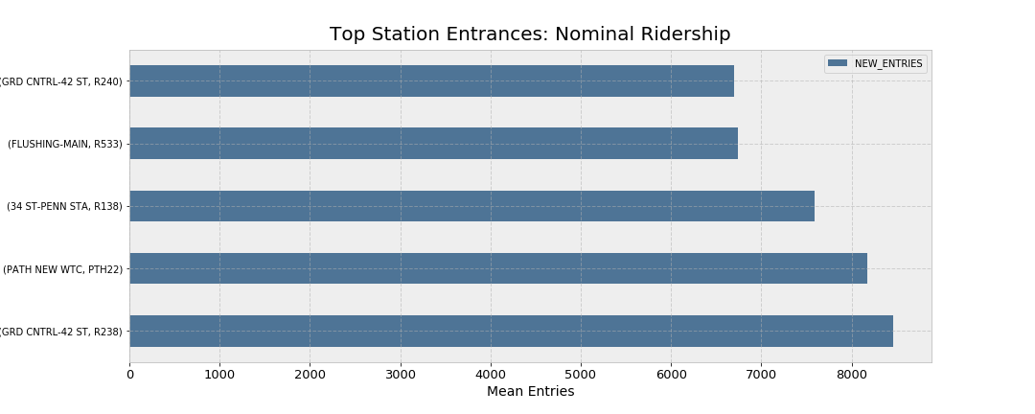
Notes:
BRAD SOLOMON
An early part of our investigation was to rank stations by nominal ridership, before considering demographics
Here, some of the usual suspects popped: Grand central, WTC, Penn Station
We call these the big 3
These stations occupied 97 of the top 100 station-time combinations
Handing it off to Audrey

Slide 10
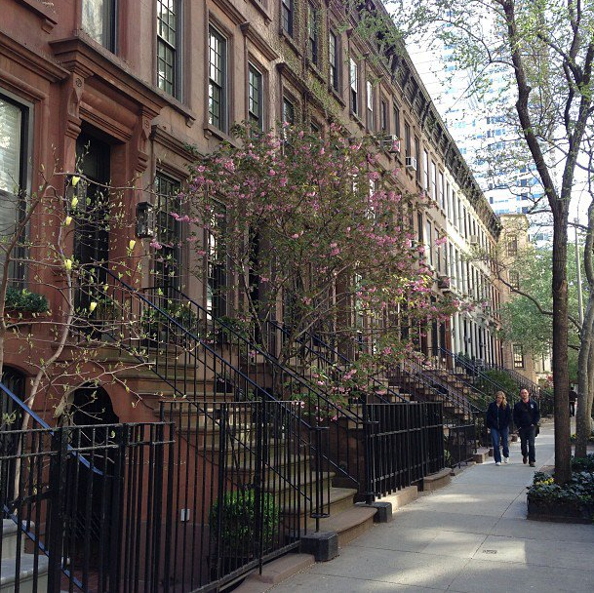
Demographically-driven focus areas
Composite score:
Women in work force
Education
Income
Notes:
AUDREY
To ID best stations for outreach to driven prof women during morning cmt, created composite demog score for SSE, using…
We then weighted foot traffic during morn cmt by demog scores
**We considered midnight – 8am only for these attributes**

Slide 11
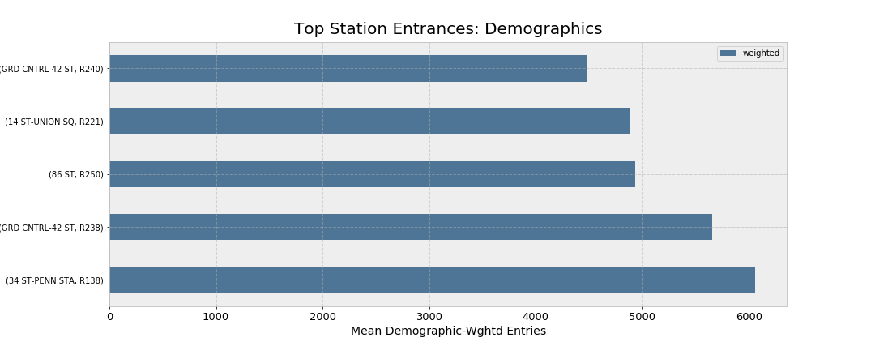
Notes:
Audrey Baker:
We then weighted foot traffic during morn cmt by demog scores (x-axis)
BOTH efficient -> reach highest volume AND focused -> high concentration of driven prof women
Fam stations + new (86st in 89th)
This is the bar chart that gives us the attractive scoring station entrances, weighted by demographic scoring. Our scoring takes into account the % of women in the workforce, education level, and income. This is relevant for entrances because this is the neighborhood where people live.
We see some repeats – high ridership and highly ranked on the demographic score
14 st and 86 st pop up in this graph because they performed well enough in the nominal ridership, and were in the top quartile for our demographic weighting.
Ex: 86th street is in the 89th percentile of our scoring, while it’s ridership is the top quartile
**We considered midnight – 8am only for these attributes**

Slide 12
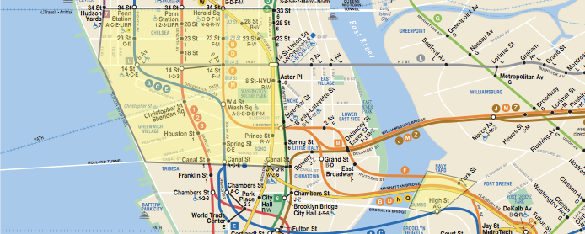
Tech business centers of NYC
Notes:
Audrey:
For aft cmt
Zero in on tech WF by building map of tech biz hubs
Giants: FB &Google
Silicon Alley: flatiron, soho dumbo, etc.
As kevin mentioned before, we did this analysis by filtering our entry data by neighborhood that have a high concentration of tech businesses.
We applied this filter onto our nominal subway entry information

Slide 13
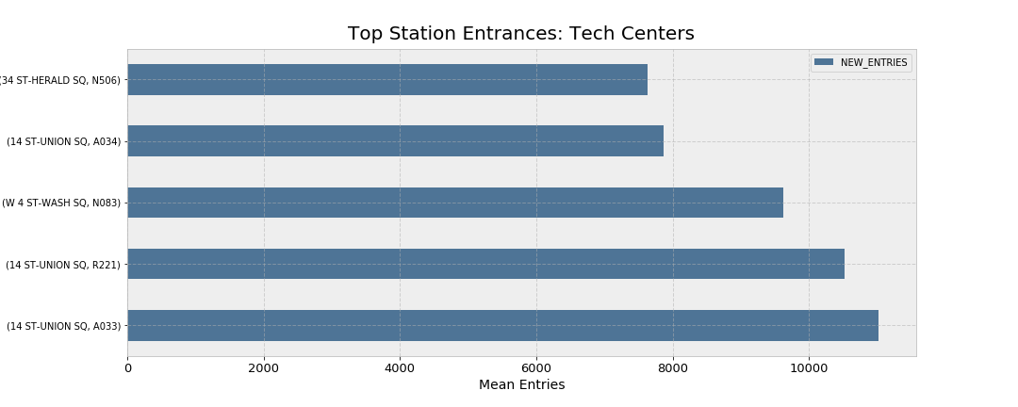
Notes:
Audrey Baker:
Looked ONLY at traffic in tech biz centers to get highest foot traffic with tech WF
Only focusing on stations within the tech centers shown in the previous slide.

Slide 14
Recommendations
Notes:
BRAD SOLOMON
To bring things together, we’d like to provide some visualization of our recommendations.

Slide 15
Morning focal points
34 St – Penn Station
42 St – Grand Central
86 St
Notes:
BRAD SOLOMON
In the morning, we recommend targeting stations that appear in demographically attractive areas that also have high ridership numbers
- Penn station & grand central (APPEARED IN NOMINAL RIDERSHIP RANK) have not only high ridership, but also demographics in the top quartile scoring
- 86th street rises to the top here because it has fairly high nominal and a demographic score in the 89th percentile

Slide 16
Evening focal points
14 St – Union Sq
W 4 St – Wash Sq
34 St – Herald Sq
Notes:
BRAD SOLOMON
Secondly, We target these areas in ”silicon alley” in an effort to capture the evening commute of the tech workforce

Slide 17
Questions?

Slide 18
Appendix

Slide 19
Data quality issues
Implausible "jumps" in implied ridership*
Arbitrary "resetting" of ridership counts
Duplicated entries
Timeslot demarcations not aligned with morning hour
Poor field documentation (lack of clarification on field hierarchy)
* On 1-22-17 at 12:00:00, the 14th St 01-03-00 turnstile (N078 R175 ACEL) had 8,476,560 cumulative entries. The next recorded entry figure was 2,130,669,389 cumulative entries, 4 hours later at 16:00:00, implying a 4-hour difference of 2.1 billion riders. ~25 such cases.
* On 1-22-17 at 12:00:00, the 14th St 01-03-00 turnstile (N078 R175 ACEL) had 8,476,560 cumulative entries. The next recorded entry figure was 2,130,669,389 cumulative entries, 4 hours later at 16:00:00, implying a 4-hour difference of 2.1 billion riders.
* On 1-22-17 at 12:00:00, the 14th St 01-03-00 turnstile (N078 R175 ACEL) had 8,476,560 cumulative entries. The next recorded entry figure was 2,130,669,389 cumulative entries, 4 hours later at 16:00:00, implying a 4-hour difference of 2.1 billion riders.

Slide 20
Detecting “true flukes” (not outliers)
As mentioned earlier, we find ~25 entries that can be deemed “unrealistic” and are removed from the dataset. (25,000+ entrants to one turnstile within 4 hours.)
However, we also find “legitimate” entries where 4-hour entry tallies are as high as the 2,500-3,500 range. (3,500 turnstile entrants in 4 hours would imply 1 entrant every 4.11 seconds.)

Slide 21
Field hierarchy
LINENAME
STATION
C/A
C/A
UNIT
UNIT
UNIT
UNIT
SCP
SCP
SCP
SCP
SCP
SCP
SCP
SCP
Split-apply-combine:
Find total entries at 4-hour intervals at the turnstile (SCP) level.
Aggregate back up to the station level (LINENAME/STATION/CA).
~2.3 million turnstile + timeslot records
Notes:
Alternate names: UNIT == REMOTE; CA == BOOTH.

Slide 22
Data sources
Core dataset:
~2.3 million records (turnstile+time pairs).
Spanning Jan 7, 2017 thru Mar 31, 2017.
Discrete differences @ 4hr intervals. (0:00, 4:00, …)
External datasets leveraged to find stops with favorable demographic concentrations:
Subway Census Tract Data.
2012-16 American Community Survey 5-Yr Estimates

Slide 23
Demographic weighting
Percentile-rank each station by it’s locale’s:
Composite education score (pct. associates degree or above);
Proportion of females in population;
Median income
Areas with missing data are assigned their field-wise median
Each station’s final score is an average of the three ranks; nominal entry figures are weighted by these scores to reach demographically attractive areas.

Slide 24
A note on memory usage
We reduce the memory footprint of our raw dataset by a factor of 3.5x, from 783.60 MB to 224.12 MB through use of categorical datatypes and integer downcasting.
Pandas pd.categorical dtype maps raw values to integer values, using an optimized int subtype but retaining unique representation.
Notes:
https://pandas-docs.github.io/pandas-docs-travis/categorical.html#memory-usage

